Slide 1


ONLINE JOB PORTAL
SUPERVISOR Mr.A.Malarmannan,M.E., AP/CSE.
PRESENTED BY
2303811710421151 – SIVA SURYA S

Slide 2

PRESENTATION OVERVIEW
  Objective
Project Introduction
Problem Statement
Methodologies (Programming concepts relevant to problem statement)
Architecture of the proposed system
List of Modules
7. Merits
8. Results and Discussion
9. Queries

Slide 3
OBJECTIVE
The primary objective of the project is to develop an efficient Online Job Portal that connects job seekers and employers. The platform aims to:
Simplify the job search and application process for candidates.
Enable employers to post jobs, search for candidates, and manage recruitment seamlessly.
Provide a user-friendly interface with robust functionalities for efficient job matching and application management.

Slide 4
PROJECT INTRODUCTION
The Online Job Portal is a web-based platform designed to bridge the gap between job seekers and employers. It provides:
A database of job listings and candidate profiles.
Tools for managing job applications and recruitments.
Notifications for job updates and recommendations.

Slide 5
PROBLEM STATEMENT
The job search and recruitment process is often inefficient and fragmented. Job seekers struggle to find relevant jobs, and employers face difficulties in managing applications and identifying the right candidates. Existing platforms lack advanced features like personalized recommendations, real-time notifications, and effective communication, leading to delays and frustration for both parties. There is a need for a streamlined, user-friendly system that simplifies job matching, application tracking, and recruitment.

Slide 6
Methodologies (Programming concepts relevant to problem statement)
Methodology:
Requirement Analysis: Understand and define the needs of job seekers, employers, and administrators.
System Design: Create a blueprint of the platform with modules for user management, job postings, search functionality, and notifications.
Resume Management: Enable file uploads and parsing for resumes using Java File I/O.
Job Search and Matching: Implement search and filtering with Java Collections (e.g., ArrayList, HashMap) and keyword matching logic.
Java Concepts:
Class and Object: Define JobSeeker, Employer, and Job as classes to represent these entities.
Inheritance: Create a base class like User and extend it for JobSeeker and Employer with additional attributes.
Encapsulation: Use private variables and public methods to ensure data security.
Multithreading:Use threads to handle multiple actions simultaneously, like sending notifications while the user interacts with the portal.

Slide 7
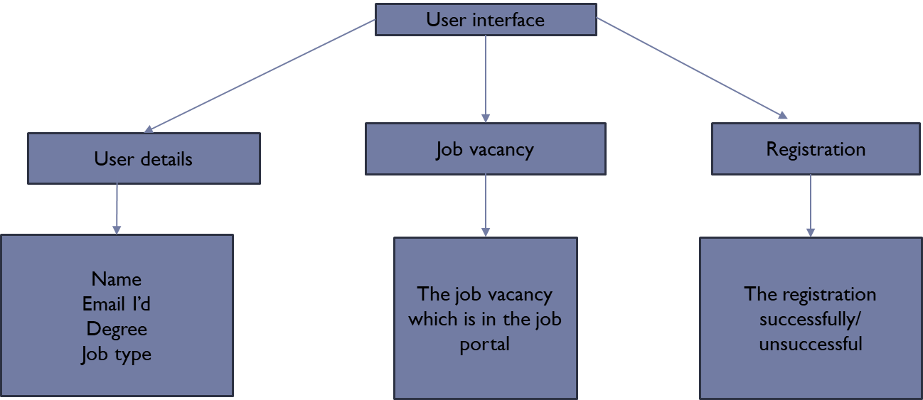
FLOW DIAGRAM

Slide 8
MODULE DESCRIPTION
User Management Module: Manages user registration, login, and profiles for job seekers and employers.
Job Management Module: Enables employers to post, update, and delete job listings.
Search Module: Provides job seekers with search and filter options for finding relevant jobs.
Application Module: Tracks job applications for seekers and manages candidate reviews for employers.
Notification Module: Sends updates and alerts about jobs and applications to users.

Slide 9
MERITS
Efficiency: Speeds up job search and recruitment processes for users.
User-Friendly: Offers an intuitive interface for easy navigation.
Automation: Reduces manual effort with features like matching algorithms and notifications.
Accessibility: Provides access on multiple devices with responsive design.
Scalability: Accommodates growing user and data volumes with cloud integration.

Slide 10
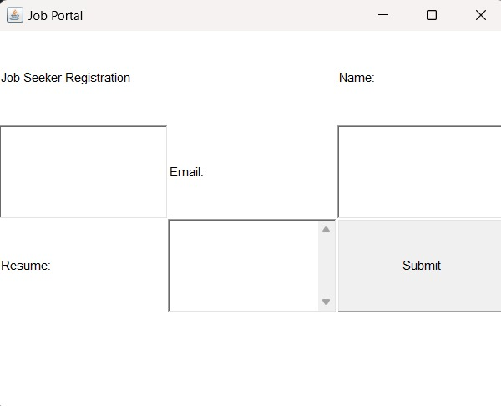
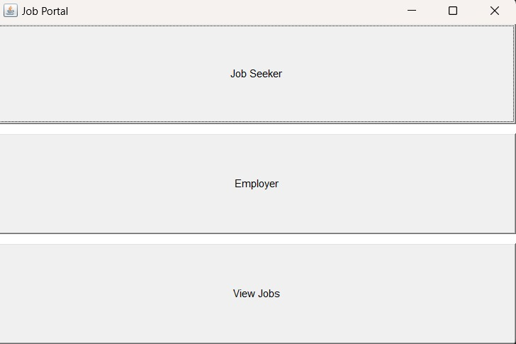
RESULT AND DISCUSSION

Slide 11
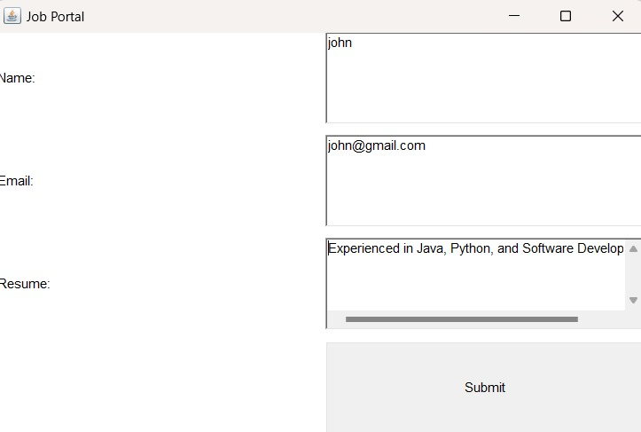
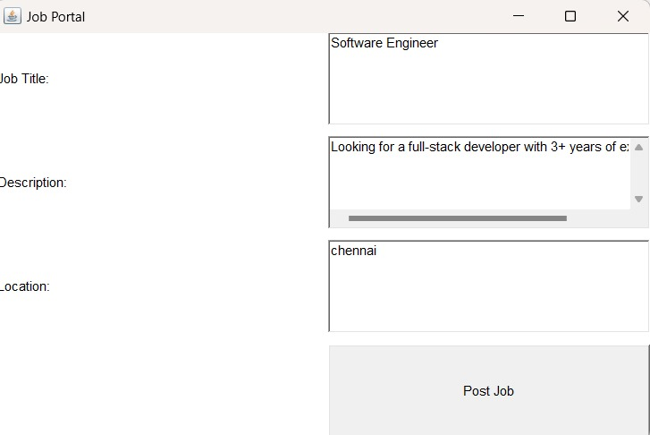

Slide 12
ANY QUERIES ?

Slide 13
THANK YOU

